Slide 1

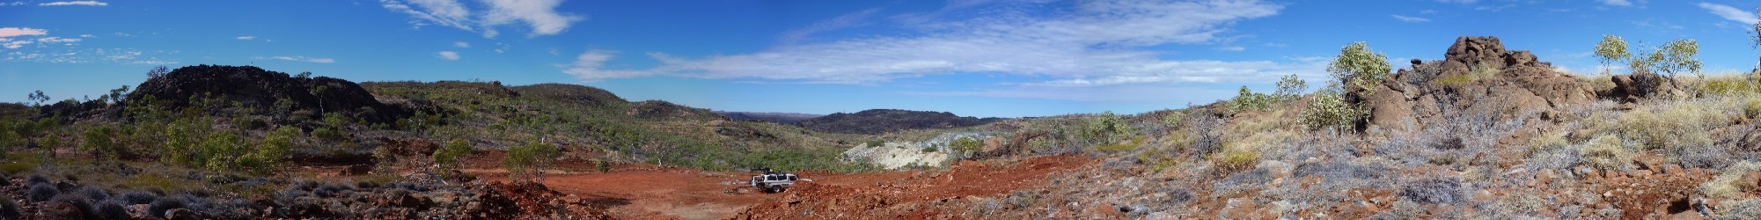
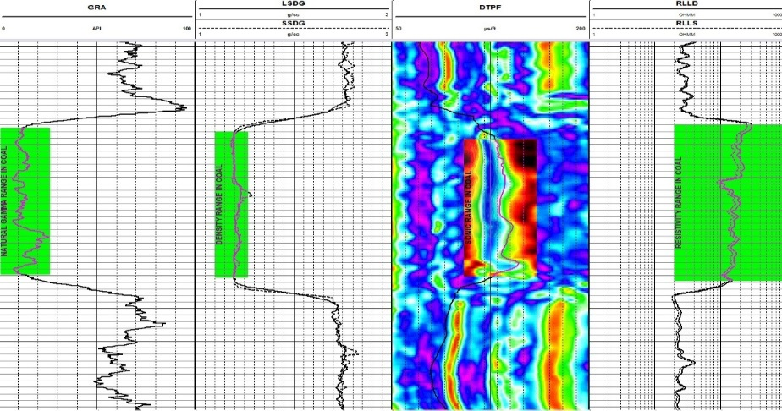
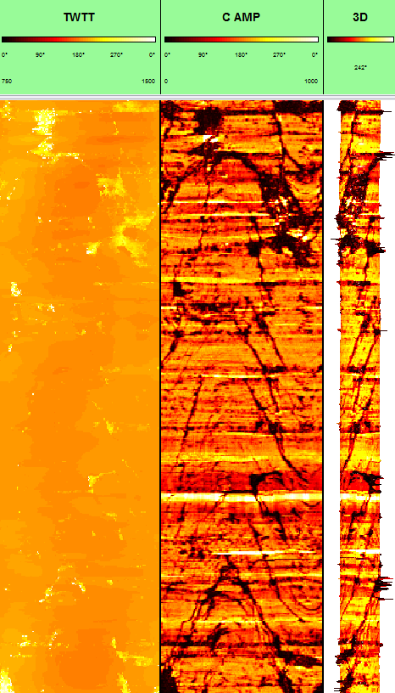
“Geophysical logging for coal - current techniques.”
downhole logging workshop,
Perth, Western Australia.
Feb 14th 2015
Notes:
Geophysical logs (downhole logs, wireline logs) are the most common source of accurate information on the depth and the apparent thickness of formation boundaries. Logs are an ideal tool for qualitative geological interpretations and can be used
in stratigraphic correlation, depth and accurate thickness determination of mineralised intervals, lithological identifications and classification of depositional environments
Giving a near continuous sample of the formation, geophysical logs analyse of volume of rock, in most cases greater than borehole volume (hence core and cuttings).
The data provided by logs are objective, repetitive and permanent. The data is obtained and processed rapidly at the borehole site and economically compared to core.
Measurements made by logging probes are strongly dependent upon formation properties.
Quantitive interpretation requires involvement of the geologist/engineer from supply of core reference data, verification boreholes through the mineralisation. Unfortunately, the geologist are not totally convinced by geophysical log data, they believe in the rock sample and not fundamentally in the log parameter.
Different professional fields, geologist, geophysicist, engineer want different things from the logdata. Team work is essential.

Slide 2
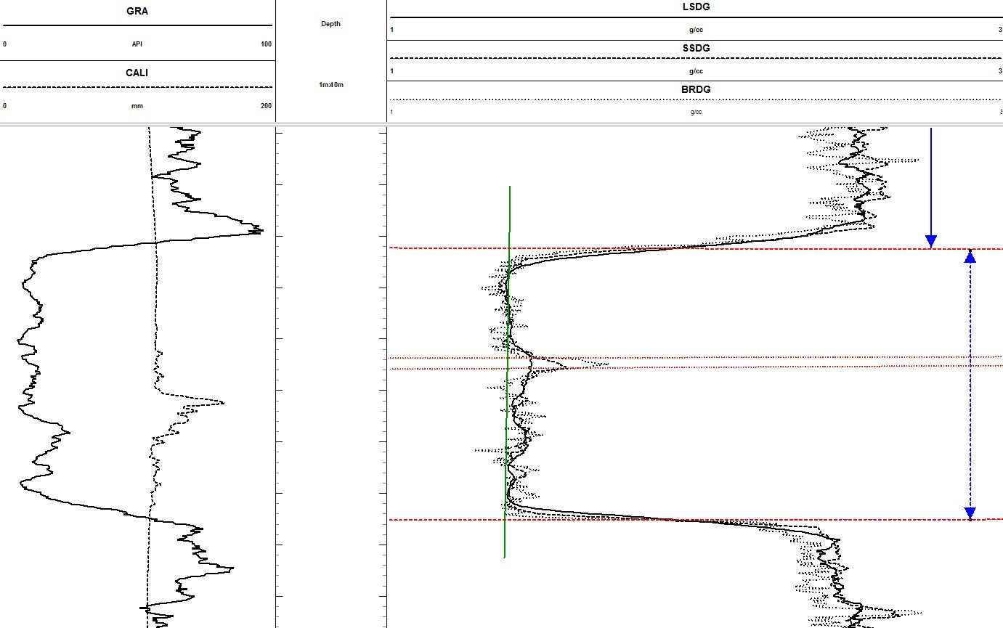
Geophysical logging for coal: coal properties
Coal is an ideal rock for geophysical logging:
bedded deposit
fills the detector sample volume.
has distinctive physical properties.
Multiple logging techniques
identify coal/partings
measure depth to roof/floor
correlate seam between boreholes
measure coal quality parameters
measure elastic rock properties/rock hardness
identify, orientate fractures/broken ground
Typical logging suite
formation density
fullwave sonic
resistivity (focused)
borehole deviation (magnetic/gyroscopic)
neutron, 3 or 4 arm dipmeter
Vertical resolution
1cm sample rate = logging speed control
Products
field prints & digital data
Notes:
Geophysical logs (downhole logs, wireline logs) are the most common source of accurate information on the depth and the apparent thickness of formation boundaries. Logs are an ideal tool for qualitative geological interpretations and can be used
in stratigraphic correlation, depth and accurate thickness determination of mineralised intervals, lithological identifications and classification of depositional environments
Giving a near continuous sample of the formation, geophysical logs analyse of volume of rock, in most cases greater than borehole volume (hence core and cuttings).
The data provided by logs are objective, repetitive and permanent. The data is obtained and processed rapidly at the borehole site and economically compared to core.
Measurements made by logging probes are strongly dependent upon formation properties.
Quantitive interpretation requires involvement of the geologist/engineer from supply of core reference data, verification boreholes through the mineralisation. Unfortunately, the geologist are not totally convinced by geophysical log data, they believe in the rock sample and not fundamentally in the log parameter.
Different professional fields, geologist, geophysicist, engineer want different things from the logdata. Team work is essential.

Slide 3
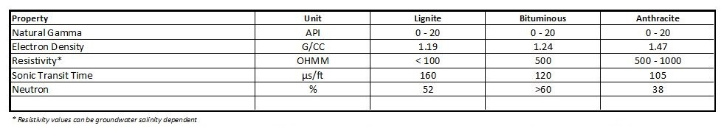
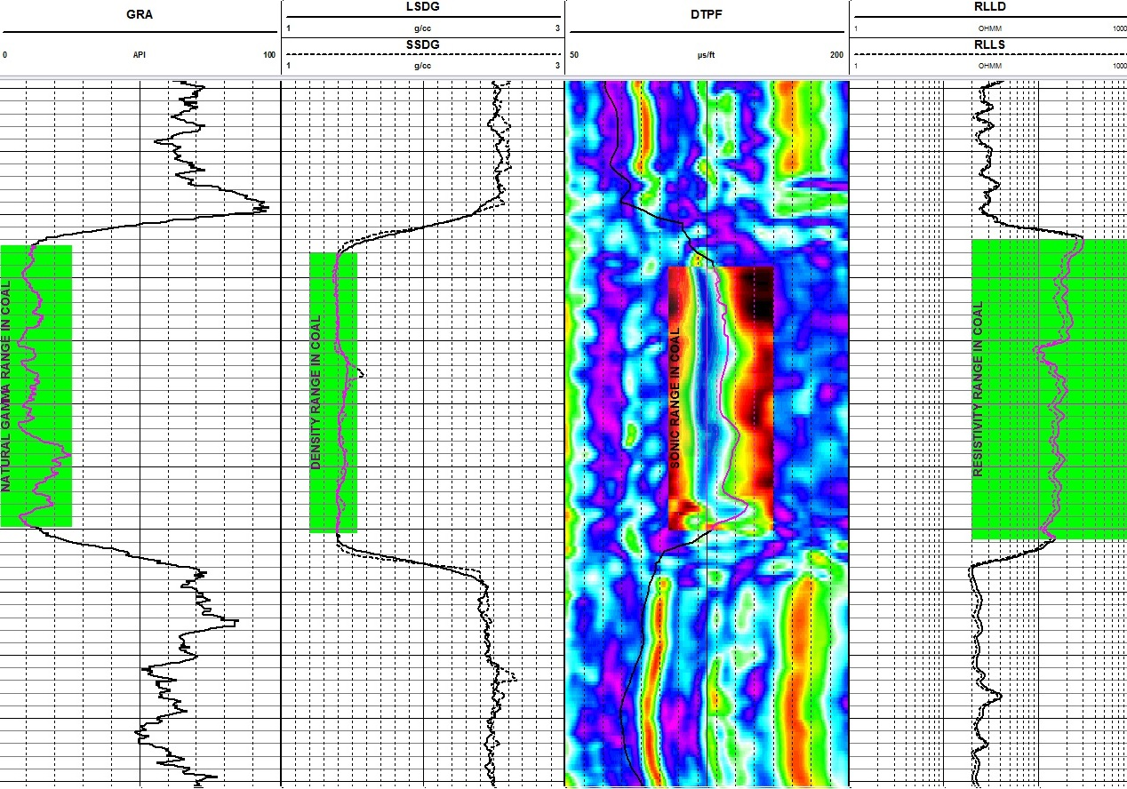
Geophysical logging for coal: typical log responses
Typical response:
low density.
low gamma.
low velocity.
high resistivity.*
Notes:
Geophysical logs (downhole logs, wireline logs) are the most common source of accurate information on the depth and the apparent thickness of formation boundaries. Logs are an ideal tool for qualitative geological interpretations and can be used
in stratigraphic correlation, depth and accurate thickness determination of mineralised intervals, lithological identifications and classification of depositional environments
Giving a near continuous sample of the formation, geophysical logs analyse of volume of rock, in most cases greater than borehole volume (hence core and cuttings).
The data provided by logs are objective, repetitive and permanent. The data is obtained and processed rapidly at the borehole site and economically compared to core.
Measurements made by logging probes are strongly dependent upon formation properties.
Quantitive interpretation requires involvement of the geologist/engineer from supply of core reference data, verification boreholes through the mineralisation. Unfortunately, the geologist are not totally convinced by geophysical log data, they believe in the rock sample and not fundamentally in the log parameter.
Different professional fields, geologist, geophysicist, engineer want different things from the logdata. Team work is essential.

Slide 4
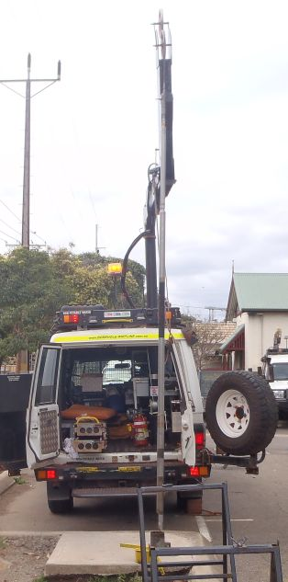
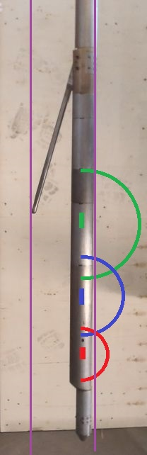
Geophysical logging for coal: formation density probe
Multi-detector probe.
typically > 3m length
gamma
density (2 or 3 detectors)
single arm caliper
CS¹³⁷ source
Single run.
Shielded detector section.
Best run in openhole conditions.
Calibrated values require fluid filled conditions.
Can be run inside drill rods/casing.
Typical source to density detectors spacing.
48cm, 24cm, 14cm
Longer spacing = larger investigation volume.
Shorter spacing = better vertical resolution.
Measurement: back scattered gamma radiation
      high count rate = low density
electron density
LSDG
SSDG
BRDG
Notes:
Geophysical logs (downhole logs, wireline logs) are the most common source of accurate information on the depth and the apparent thickness of formation boundaries. Logs are an ideal tool for qualitative geological interpretations and can be used
in stratigraphic correlation, depth and accurate thickness determination of mineralised intervals, lithological identifications and classification of depositional environments
Giving a near continuous sample of the formation, geophysical logs analyse of volume of rock, in most cases greater than borehole volume (hence core and cuttings).
The data provided by logs are objective, repetitive and permanent. The data is obtained and processed rapidly at the borehole site and economically compared to core.
Measurements made by logging probes are strongly dependent upon formation properties.
Quantitive interpretation requires involvement of the geologist/engineer from supply of core reference data, verification boreholes through the mineralisation. Unfortunately, the geologist are not totally convinced by geophysical log data, they believe in the rock sample and not fundamentally in the log parameter.
Different professional fields, geologist, geophysicist, engineer want different things from the logdata. Team work is essential.

Slide 5
Geophysical logging for coal: formation density curves & products
Density: coal quality measurement
long spaced detector
(LSDG, DENL)
Density: bed boundary measurement
  short spaced detector (SSDG) 25cm
  bed resolution detector (BRDG, DENB) 14cm
  shoulder bed
Notes:
Geophysical logs (downhole logs, wireline logs) are the most common source of accurate information on the depth and the apparent thickness of formation boundaries. Logs are an ideal tool for qualitative geological interpretations and can be used
in stratigraphic correlation, depth and accurate thickness determination of mineralised intervals, lithological identifications and classification of depositional environments
Giving a near continuous sample of the formation, geophysical logs analyse of volume of rock, in most cases greater than borehole volume (hence core and cuttings).
The data provided by logs are objective, repetitive and permanent. The data is obtained and processed rapidly at the borehole site and economically compared to core.
Measurements made by logging probes are strongly dependent upon formation properties.
Quantitive interpretation requires involvement of the geologist/engineer from supply of core reference data, verification boreholes through the mineralisation. Unfortunately, the geologist are not totally convinced by geophysical log data, they believe in the rock sample and not fundamentally in the log parameter.
Different professional fields, geologist, geophysicist, engineer want different things from the logdata. Team work is essential.

Slide 6
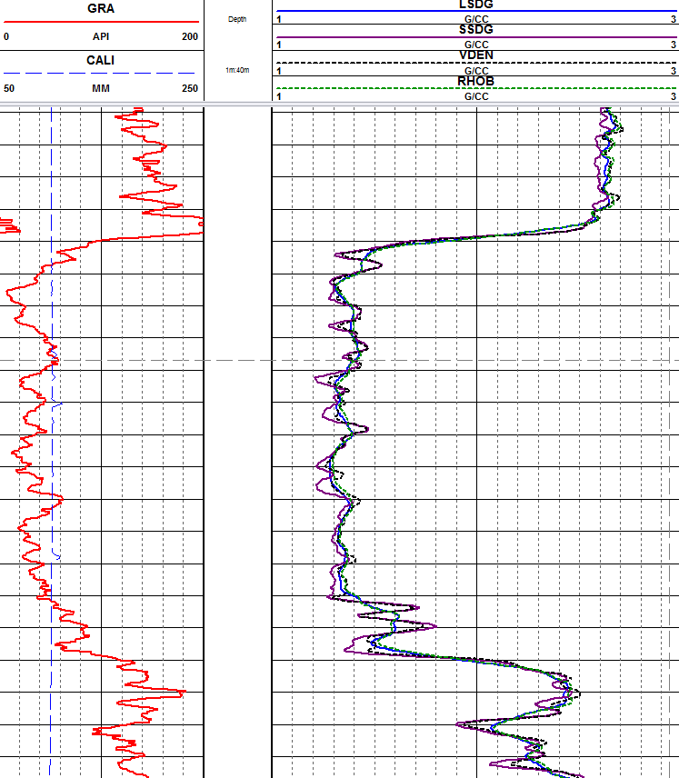
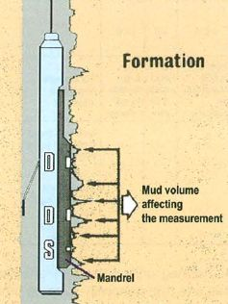
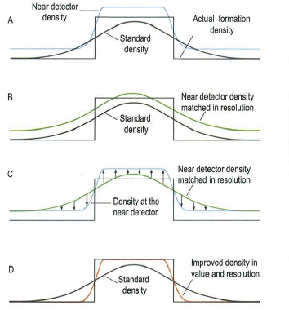

Geophysical logging for coal: advanced processing
Density compensation
primarily develop to offset mudcake effect.
computation using long/short spaced detectors.
Density filtering
  vector (alpha) processing
  attempts to match detector sample volumes
Notes:
Geophysical logs (downhole logs, wireline logs) are the most common source of accurate information on the depth and the apparent thickness of formation boundaries. Logs are an ideal tool for qualitative geological interpretations and can be used
in stratigraphic correlation, depth and accurate thickness determination of mineralised intervals, lithological identifications and classification of depositional environments
Giving a near continuous sample of the formation, geophysical logs analyse of volume of rock, in most cases greater than borehole volume (hence core and cuttings).
The data provided by logs are objective, repetitive and permanent. The data is obtained and processed rapidly at the borehole site and economically compared to core.
Measurements made by logging probes are strongly dependent upon formation properties.
Quantitive interpretation requires involvement of the geologist/engineer from supply of core reference data, verification boreholes through the mineralisation. Unfortunately, the geologist are not totally convinced by geophysical log data, they believe in the rock sample and not fundamentally in the log parameter.
Different professional fields, geologist, geophysicist, engineer want different things from the logdata. Team work is essential.

Slide 7
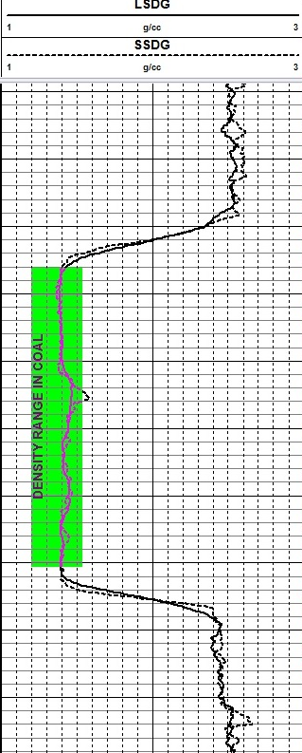
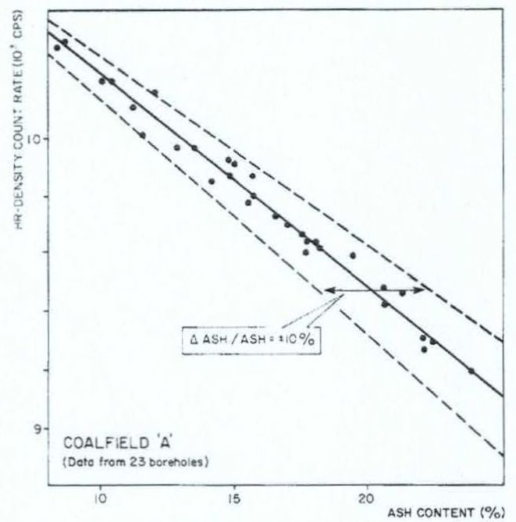
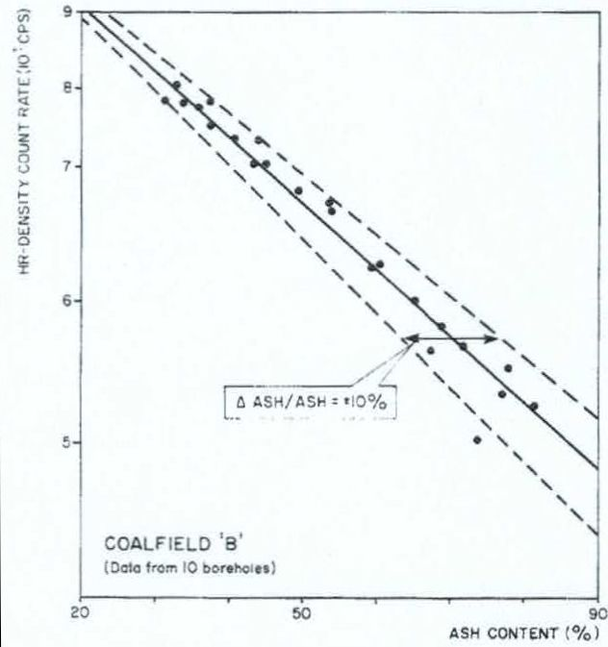
Geophysical logging for coal: formation density curves & products
Density: coal quality parameters
coal rank, calorific value, ash.
Density: coal rank
Density: ash content
Increasing coal rank
Lower density
Higher ash content
Notes:
Geophysical logs (downhole logs, wireline logs) are the most common source of accurate information on the depth and the apparent thickness of formation boundaries. Logs are an ideal tool for qualitative geological interpretations and can be used
in stratigraphic correlation, depth and accurate thickness determination of mineralised intervals, lithological identifications and classification of depositional environments
Giving a near continuous sample of the formation, geophysical logs analyse of volume of rock, in most cases greater than borehole volume (hence core and cuttings).
The data provided by logs are objective, repetitive and permanent. The data is obtained and processed rapidly at the borehole site and economically compared to core.
Measurements made by logging probes are strongly dependent upon formation properties.
Quantitive interpretation requires involvement of the geologist/engineer from supply of core reference data, verification boreholes through the mineralisation. Unfortunately, the geologist are not totally convinced by geophysical log data, they believe in the rock sample and not fundamentally in the log parameter.
Different professional fields, geologist, geophysicist, engineer want different things from the logdata. Team work is essential.

Slide 8
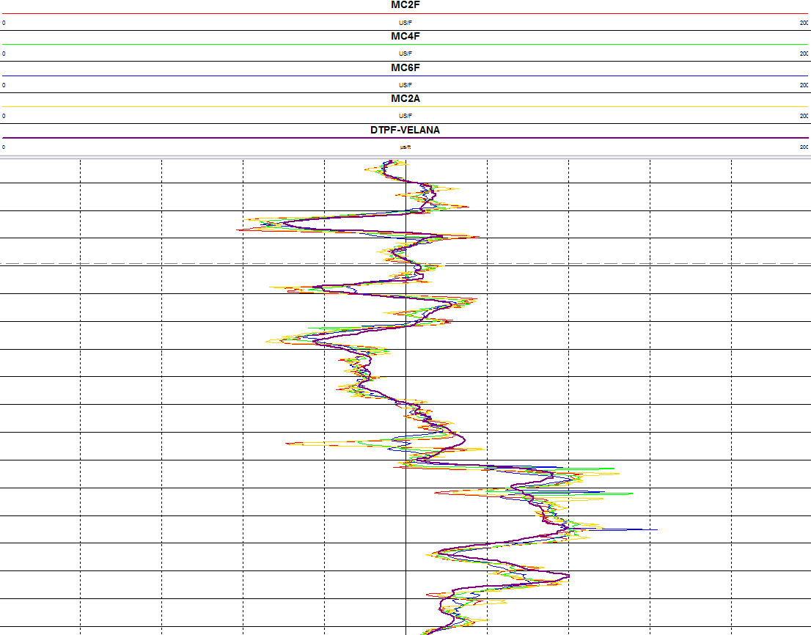
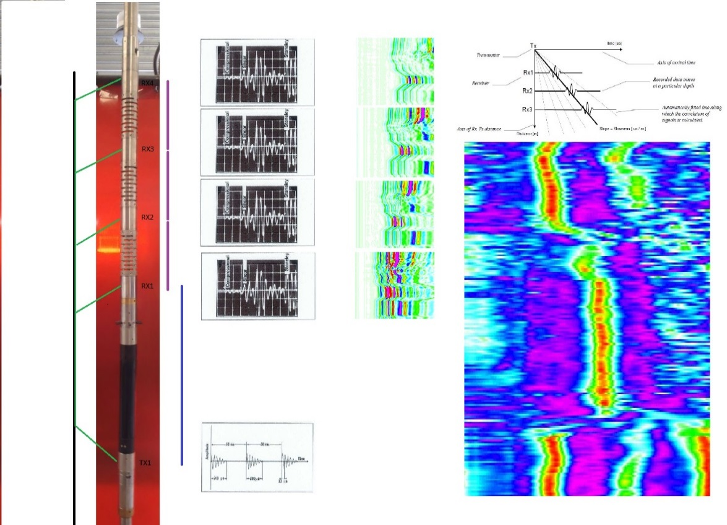
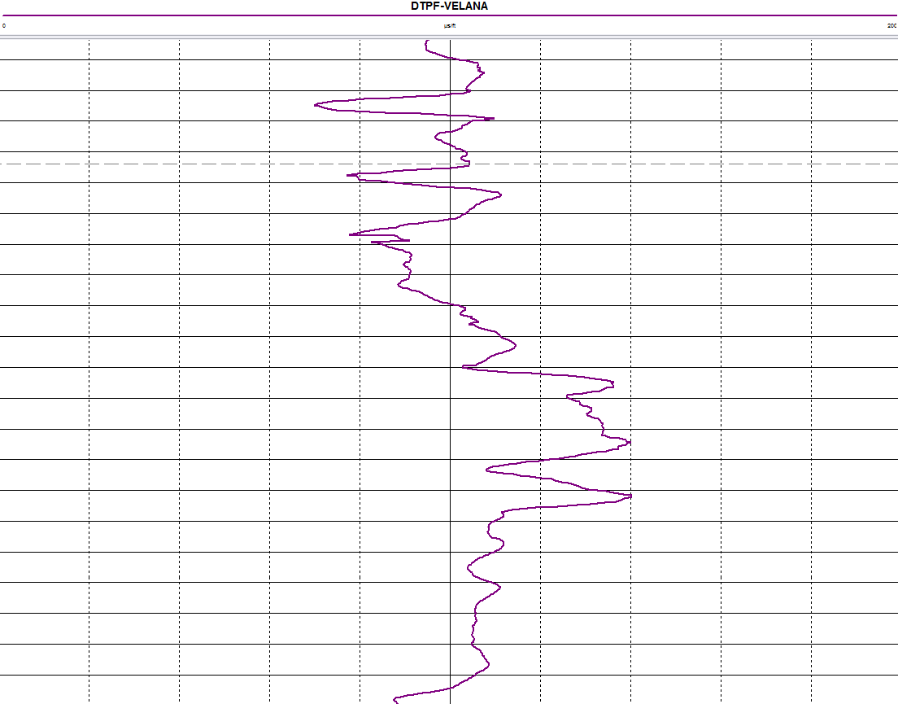
Geophysical logging for coal: sonic probe - FULLWAVE
Multi-receivers probe.
1TX-4RX 60cm, 80cm, 100cm, 120cm receiver spacings
measures received waveform for short period at each receiver
Requires openhole and fluid filled conditions.
Measurement: pressure pulse transmitter/receiver(s).
  Can measure compressional, shear and tube wave arrival times
  Used in calculation for elastic rock properties
Multi-channel curves & VELANA curve
Receivers – fullwave
Signal processing
Receiver Spacing's
VELANA curve
Ray Paths
Transmitter pulses
Velocity analysis
Notes:
Geophysical logs (downhole logs, wireline logs) are the most common source of accurate information on the depth and the apparent thickness of formation boundaries. Logs are an ideal tool for qualitative geological interpretations and can be used
in stratigraphic correlation, depth and accurate thickness determination of mineralised intervals, lithological identifications and classification of depositional environments
Giving a near continuous sample of the formation, geophysical logs analyse of volume of rock, in most cases greater than borehole volume (hence core and cuttings).
The data provided by logs are objective, repetitive and permanent. The data is obtained and processed rapidly at the borehole site and economically compared to core.
Measurements made by logging probes are strongly dependent upon formation properties.
Quantitive interpretation requires involvement of the geologist/engineer from supply of core reference data, verification boreholes through the mineralisation. Unfortunately, the geologist are not totally convinced by geophysical log data, they believe in the rock sample and not fundamentally in the log parameter.
Different professional fields, geologist, geophysicist, engineer want different things from the logdata. Team work is essential.

Slide 9
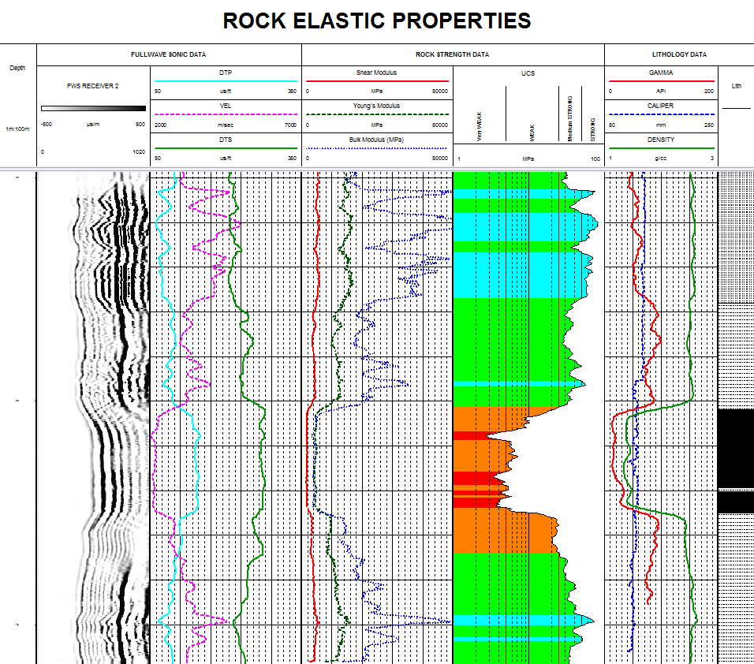
Geophysical logging for coal: fullwave sonic curves & products
Fullwave Sonic:
Transit time DTPF, DTSF (compressional, shear & tube arrival curves)
Transit time MC2F, MC4F, MC6F, MC2A (multichannel curves)
Fullwave data can be used to generate elastic moduli.
Poisson’s Ratio, Young’s Modulus, Shear Modulus
Notes:
Geophysical logs (downhole logs, wireline logs) are the most common source of accurate information on the depth and the apparent thickness of formation boundaries. Logs are an ideal tool for qualitative geological interpretations and can be used
in stratigraphic correlation, depth and accurate thickness determination of mineralised intervals, lithological identifications and classification of depositional environments
Giving a near continuous sample of the formation, geophysical logs analyse of volume of rock, in most cases greater than borehole volume (hence core and cuttings).
The data provided by logs are objective, repetitive and permanent. The data is obtained and processed rapidly at the borehole site and economically compared to core.
Measurements made by logging probes are strongly dependent upon formation properties.
Quantitive interpretation requires involvement of the geologist/engineer from supply of core reference data, verification boreholes through the mineralisation. Unfortunately, the geologist are not totally convinced by geophysical log data, they believe in the rock sample and not fundamentally in the log parameter.
Different professional fields, geologist, geophysicist, engineer want different things from the logdata. Team work is essential.

Slide 10
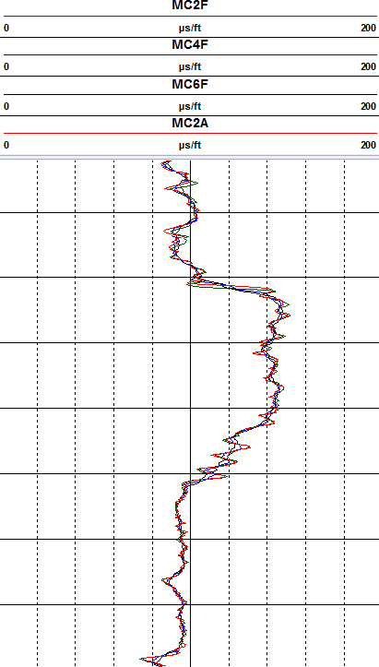
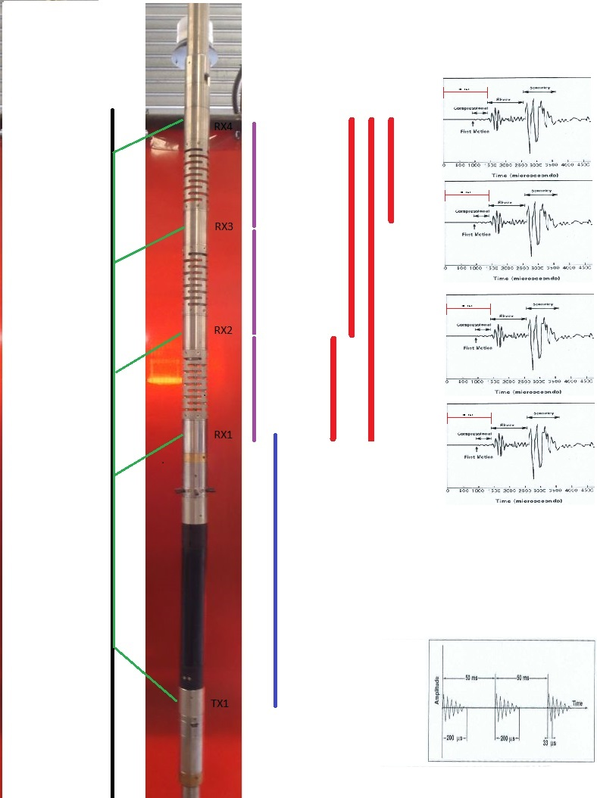
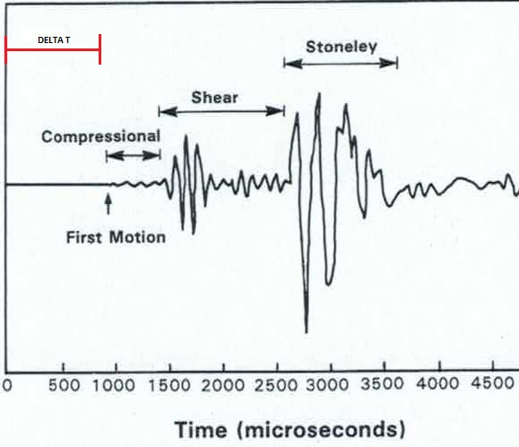
Geophysical logging for coal: sonic probe – TRANSIT TIME
Multi-receivers probe.
1TX-4RX 60cm, 80cm, 100cm, 120cm receiver spacings
Requires openhole and fluid filled conditions.
Measurement: pressure pulse transmitter/receiver(s).
Transit time between receivers of compressional arrival only
Receivers – dt only
Receiver Spacing's
Multichannel curves
Ray Paths
Transmitter pulses
Multichannel sonic
Notes:
Geophysical logs (downhole logs, wireline logs) are the most common source of accurate information on the depth and the apparent thickness of formation boundaries. Logs are an ideal tool for qualitative geological interpretations and can be used
in stratigraphic correlation, depth and accurate thickness determination of mineralised intervals, lithological identifications and classification of depositional environments
Giving a near continuous sample of the formation, geophysical logs analyse of volume of rock, in most cases greater than borehole volume (hence core and cuttings).
The data provided by logs are objective, repetitive and permanent. The data is obtained and processed rapidly at the borehole site and economically compared to core.
Measurements made by logging probes are strongly dependent upon formation properties.
Quantitive interpretation requires involvement of the geologist/engineer from supply of core reference data, verification boreholes through the mineralisation. Unfortunately, the geologist are not totally convinced by geophysical log data, they believe in the rock sample and not fundamentally in the log parameter.
Different professional fields, geologist, geophysicist, engineer want different things from the logdata. Team work is essential.

Slide 11
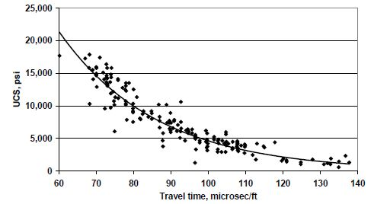
Geophysical logging for coal: curves & products
Sonic:
Compressional arrival times only
Transit time DTPF.
Transit time MC2F, MC4F, MC6F, MC2A (multichannel).
Empirical relationships established for engineering purposes.
Project area specific
DT V UCS, McNally 1987
Notes:
Geophysical logs (downhole logs, wireline logs) are the most common source of accurate information on the depth and the apparent thickness of formation boundaries. Logs are an ideal tool for qualitative geological interpretations and can be used
in stratigraphic correlation, depth and accurate thickness determination of mineralised intervals, lithological identifications and classification of depositional environments
Giving a near continuous sample of the formation, geophysical logs analyse of volume of rock, in most cases greater than borehole volume (hence core and cuttings).
The data provided by logs are objective, repetitive and permanent. The data is obtained and processed rapidly at the borehole site and economically compared to core.
Measurements made by logging probes are strongly dependent upon formation properties.
Quantitive interpretation requires involvement of the geologist/engineer from supply of core reference data, verification boreholes through the mineralisation. Unfortunately, the geologist are not totally convinced by geophysical log data, they believe in the rock sample and not fundamentally in the log parameter.
Different professional fields, geologist, geophysicist, engineer want different things from the logdata. Team work is essential.

Slide 12
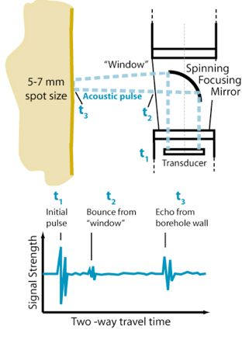
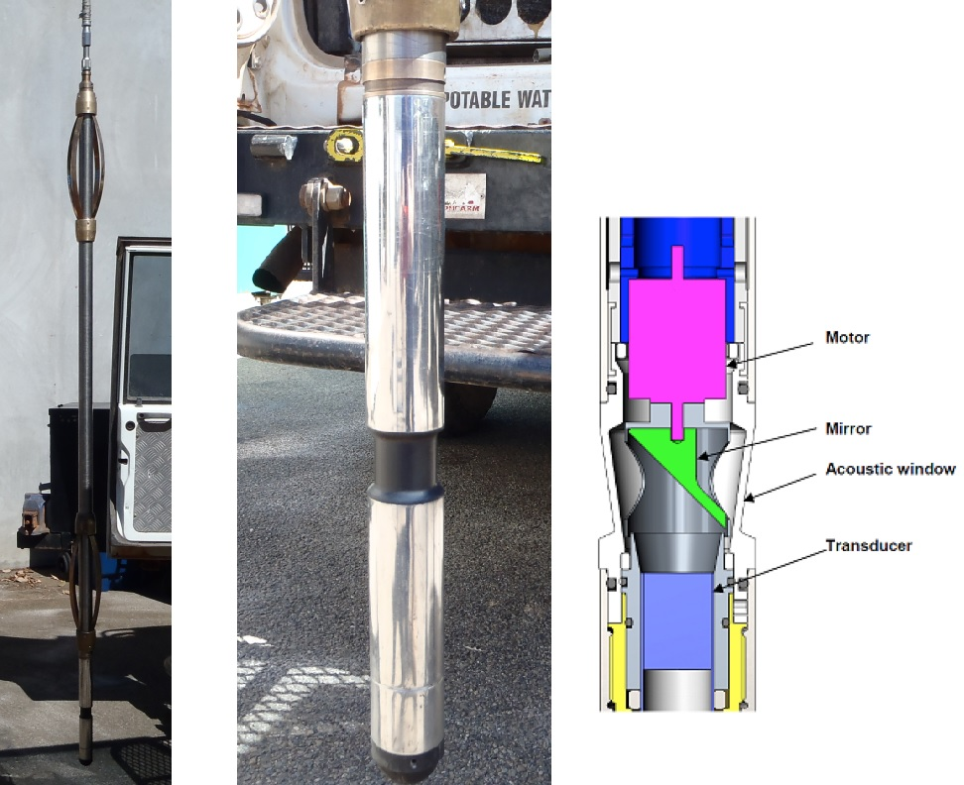
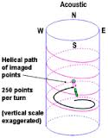
Geophysical logging for coal: acoustic scanner
Borehole acoustic imaging probe.
multiple “echoes” around borehole reflecting acoustic impedance.
Multi-detector probe.
acoustic head: transmitter-receiver/rotating mirror
images: travel time & amplitude
image orientation: 3 axis magnetometers & accelerometers
Logging.
  probe needs to be centrallised in the borehole & requires fluid.
Notes:
Geophysical logs (downhole logs, wireline logs) are the most common source of accurate information on the depth and the apparent thickness of formation boundaries. Logs are an ideal tool for qualitative geological interpretations and can be used
in stratigraphic correlation, depth and accurate thickness determination of mineralised intervals, lithological identifications and classification of depositional environments
Giving a near continuous sample of the formation, geophysical logs analyse of volume of rock, in most cases greater than borehole volume (hence core and cuttings).
The data provided by logs are objective, repetitive and permanent. The data is obtained and processed rapidly at the borehole site and economically compared to core.
Measurements made by logging probes are strongly dependent upon formation properties.
Quantitive interpretation requires involvement of the geologist/engineer from supply of core reference data, verification boreholes through the mineralisation. Unfortunately, the geologist are not totally convinced by geophysical log data, they believe in the rock sample and not fundamentally in the log parameter.
Different professional fields, geologist, geophysicist, engineer want different things from the logdata. Team work is essential.

Slide 13
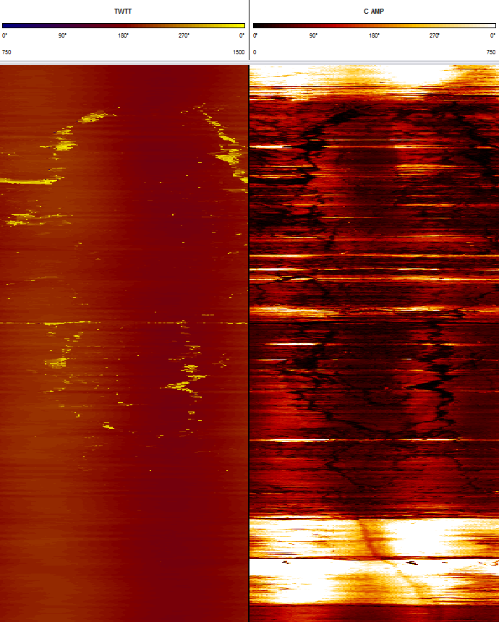
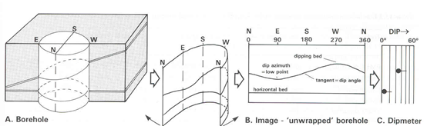
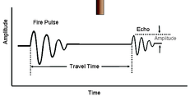
Geophysical logging for coal: acoustic scanner
Products.
2 unwrapped orientated images.
dipping structures form sine curves.
interactive “picking” for structure dip & dip direction
Travel Time.
two way: transducer-borehole-wall-transducer.
“multi-fingered caliper”
borehole volume, borehole shape
Amplitude.
acoustic impedance contrast.
high amplitude: hard rock
low amplitude: soft rock, fluid
Uses.
structure orientation, identification & classification.
high resolution caliper
unwrapped images
Notes:
Geophysical logs (downhole logs, wireline logs) are the most common source of accurate information on the depth and the apparent thickness of formation boundaries. Logs are an ideal tool for qualitative geological interpretations and can be used
in stratigraphic correlation, depth and accurate thickness determination of mineralised intervals, lithological identifications and classification of depositional environments
Giving a near continuous sample of the formation, geophysical logs analyse of volume of rock, in most cases greater than borehole volume (hence core and cuttings).
The data provided by logs are objective, repetitive and permanent. The data is obtained and processed rapidly at the borehole site and economically compared to core.
Measurements made by logging probes are strongly dependent upon formation properties.
Quantitive interpretation requires involvement of the geologist/engineer from supply of core reference data, verification boreholes through the mineralisation. Unfortunately, the geologist are not totally convinced by geophysical log data, they believe in the rock sample and not fundamentally in the log parameter.
Different professional fields, geologist, geophysicist, engineer want different things from the logdata. Team work is essential.

Slide 14
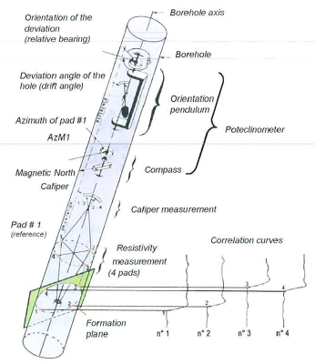
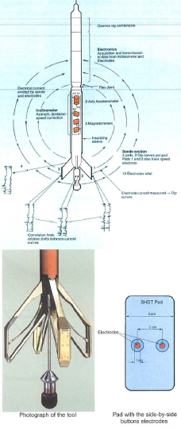
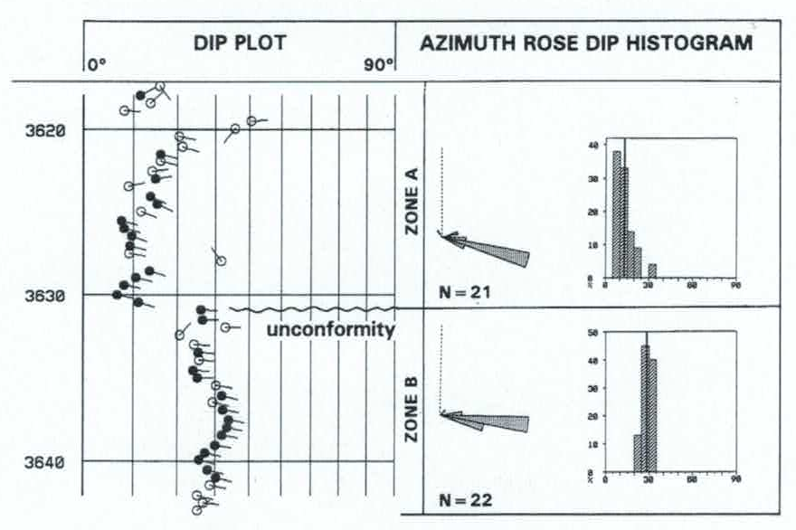
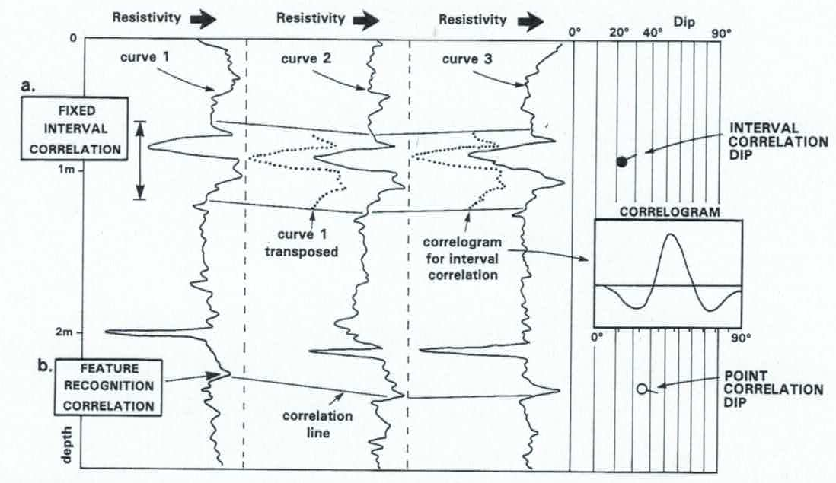
Geophysical logging for coal: resistivity imaging
3 or 4 arm dipmeter
micro resistivity technique through electrode on pad.
available since early 1980’s.
pad resistivity curves orientated by internal magnetometers/inclinometers.
3 or 4 curves processed for correlation – result in tadpole plot.
currently being superseded by multiple electrodes per pad.
good for geological information – faults, unconformities
Notes:
Geophysical logs (downhole logs, wireline logs) are the most common source of accurate information on the depth and the apparent thickness of formation boundaries. Logs are an ideal tool for qualitative geological interpretations and can be used
in stratigraphic correlation, depth and accurate thickness determination of mineralised intervals, lithological identifications and classification of depositional environments
Giving a near continuous sample of the formation, geophysical logs analyse of volume of rock, in most cases greater than borehole volume (hence core and cuttings).
The data provided by logs are objective, repetitive and permanent. The data is obtained and processed rapidly at the borehole site and economically compared to core.
Measurements made by logging probes are strongly dependent upon formation properties.
Quantitive interpretation requires involvement of the geologist/engineer from supply of core reference data, verification boreholes through the mineralisation. Unfortunately, the geologist are not totally convinced by geophysical log data, they believe in the rock sample and not fundamentally in the log parameter.
Different professional fields, geologist, geophysicist, engineer want different things from the logdata. Team work is essential.

Slide 15
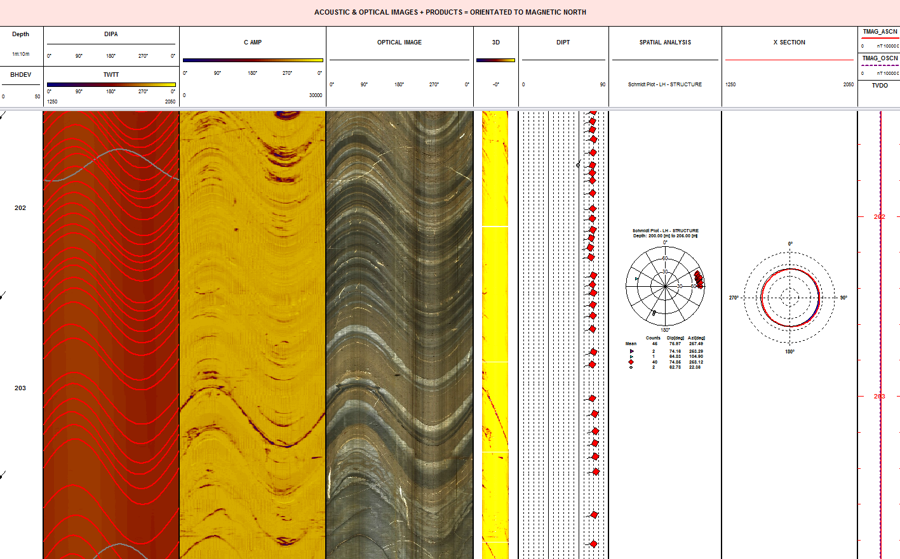
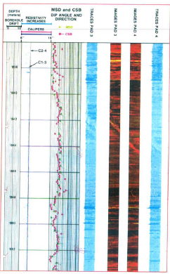
Geophysical logging for coal: dipmeter v acoustic/optical scanner
dipmeter v acoustic/optical scanners
acoustic/optical scanners: dipmeter:
common availability today. limited availability.
greater coverage of borehole. single electrode/pad = limited coverage.
geological and geotechnical applications. coal, geological applications.
manual processing automated processing
Notes:
Geophysical logs (downhole logs, wireline logs) are the most common source of accurate information on the depth and the apparent thickness of formation boundaries. Logs are an ideal tool for qualitative geological interpretations and can be used
in stratigraphic correlation, depth and accurate thickness determination of mineralised intervals, lithological identifications and classification of depositional environments
Giving a near continuous sample of the formation, geophysical logs analyse of volume of rock, in most cases greater than borehole volume (hence core and cuttings).
The data provided by logs are objective, repetitive and permanent. The data is obtained and processed rapidly at the borehole site and economically compared to core.
Measurements made by logging probes are strongly dependent upon formation properties.
Quantitive interpretation requires involvement of the geologist/engineer from supply of core reference data, verification boreholes through the mineralisation. Unfortunately, the geologist are not totally convinced by geophysical log data, they believe in the rock sample and not fundamentally in the log parameter.
Different professional fields, geologist, geophysicist, engineer want different things from the logdata. Team work is essential.

Slide 16
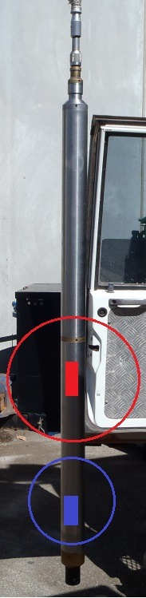
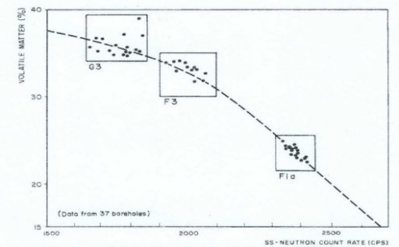
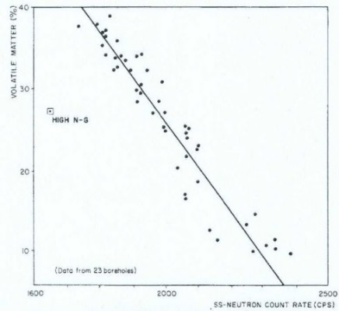
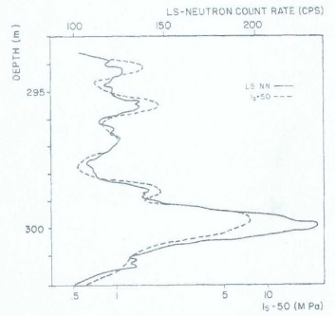
Geophysical logging for coal: neutron probe
Best run in openhole conditions.
Calibrated values require fluid filled conditions.
Measurement: neutron collisions – hydrogen Index.
porosity from long/short ratio.
Coal quality parameters:
volatile matter, moisture.
Engineering properties:
good relationship to point load tests.
ALARA:
high activity source.
        enhanced security requirement
        user/store/transport.
higher % volatiles
Higher neutron count rate
Higher neutron count rate
Higher Load Pressure
Notes:
Geophysical logs (downhole logs, wireline logs) are the most common source of accurate information on the depth and the apparent thickness of formation boundaries. Logs are an ideal tool for qualitative geological interpretations and can be used
in stratigraphic correlation, depth and accurate thickness determination of mineralised intervals, lithological identifications and classification of depositional environments
Giving a near continuous sample of the formation, geophysical logs analyse of volume of rock, in most cases greater than borehole volume (hence core and cuttings).
The data provided by logs are objective, repetitive and permanent. The data is obtained and processed rapidly at the borehole site and economically compared to core.
Measurements made by logging probes are strongly dependent upon formation properties.
Quantitive interpretation requires involvement of the geologist/engineer from supply of core reference data, verification boreholes through the mineralisation. Unfortunately, the geologist are not totally convinced by geophysical log data, they believe in the rock sample and not fundamentally in the log parameter.
Different professional fields, geologist, geophysicist, engineer want different things from the logdata. Team work is essential.

Slide 17
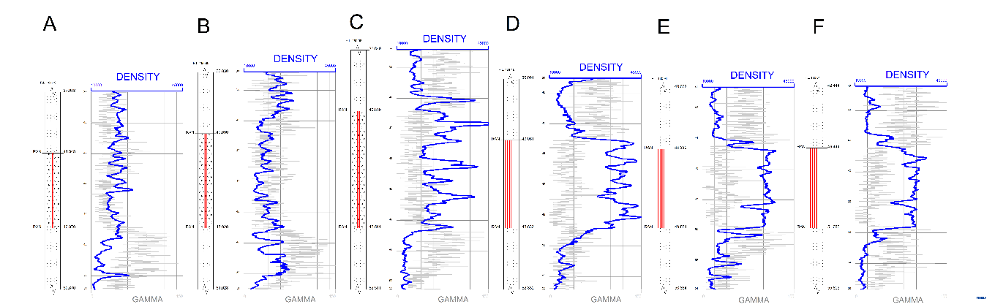
Geophysical logging for coal: regional correlation
Example
blasthole logging
shows “fading” of coal seam due to nearby igneous intrusion.
Before blasthole logging
top of coal identified by “touch drilling” resulting in coal seam damage after blast.
blast pattern based upon 250m grid from exploration drilling.
With blasthole logging
allows blast pattern to be based on 20m grid, hard/soft layers to be identified, top of coal accurately identified = remodelling/customisation pre-blast .
improves predictability, mining performance & better commercial decisions.
Notes:
Geophysical logs (downhole logs, wireline logs) are the most common source of accurate information on the depth and the apparent thickness of formation boundaries. Logs are an ideal tool for qualitative geological interpretations and can be used
in stratigraphic correlation, depth and accurate thickness determination of mineralised intervals, lithological identifications and classification of depositional environments
Giving a near continuous sample of the formation, geophysical logs analyse of volume of rock, in most cases greater than borehole volume (hence core and cuttings).
The data provided by logs are objective, repetitive and permanent. The data is obtained and processed rapidly at the borehole site and economically compared to core.
Measurements made by logging probes are strongly dependent upon formation properties.
Quantitive interpretation requires involvement of the geologist/engineer from supply of core reference data, verification boreholes through the mineralisation. Unfortunately, the geologist are not totally convinced by geophysical log data, they believe in the rock sample and not fundamentally in the log parameter.
Different professional fields, geologist, geophysicist, engineer want different things from the logdata. Team work is essential.

Slide 18
Geophysical logging for coal: SUMMARY
Geophysical logging is ideally suited to coal exploration:
coal is a bedded deposit which easily fills the sample volume of common logging methods.
allows accurate depth, thickness, grade (quality) measurements.
historical empirical relationships to coal quality and engineering parameters.
Typical logging suite:
Formation density including gamma, dual/triple density, caliper.
Fullwave sonic.
Focused resistivity.
Acoustic borehole imaging.
Magnetic deviation.
Ideal for regional correlation:
fault interpretation.
variation in coal quality parameters.
THANK YOU – QUESTIONS ?
Follow up questions ? Please visit us at booth #94 of the Trade Exhibition
Notes:
Geophysical logs (downhole logs, wireline logs) are the most common source of accurate information on the depth and the apparent thickness of formation boundaries. Logs are an ideal tool for qualitative geological interpretations and can be used
in stratigraphic correlation, depth and accurate thickness determination of mineralised intervals, lithological identifications and classification of depositional environments
Giving a near continuous sample of the formation, geophysical logs analyse of volume of rock, in most cases greater than borehole volume (hence core and cuttings).
The data provided by logs are objective, repetitive and permanent. The data is obtained and processed rapidly at the borehole site and economically compared to core.
Measurements made by logging probes are strongly dependent upon formation properties.
Quantitive interpretation requires involvement of the geologist/engineer from supply of core reference data, verification boreholes through the mineralisation. Unfortunately, the geologist are not totally convinced by geophysical log data, they believe in the rock sample and not fundamentally in the log parameter.
Different professional fields, geologist, geophysicist, engineer want different things from the logdata. Team work is essential.

Slide 19
Geophysical logs: REFERENCES
“Integrating blastholes into exploration data to improve coal recovery & modelling”. Stedman H 9th International Mining Geology Conference, August 2014.
“Well logging: Data acquisition & applications”. O & L Serra.
“Applications of petrophysical logging in the evaluation of coal deposits”. Brom, RWC & Driedonks, F. SPWLA. 1981
“Well logging for physical properties – A handbook for geophysicists, geologists & engineers”. Hearst, JR, Nelson, PH & Paillett, FL. Wiley.
“The geological interpretation of well logs”, 2nd edition, Rider, M
“Log data acquisition & quality control”, 2nd edition, Theys, P
Notes:
Geophysical logs (downhole logs, wireline logs) are the most common source of accurate information on the depth and the apparent thickness of formation boundaries. Logs are an ideal tool for qualitative geological interpretations and can be used
in stratigraphic correlation, depth and accurate thickness determination of mineralised intervals, lithological identifications and classification of depositional environments
Giving a near continuous sample of the formation, geophysical logs analyse of volume of rock, in most cases greater than borehole volume (hence core and cuttings).
The data provided by logs are objective, repetitive and permanent. The data is obtained and processed rapidly at the borehole site and economically compared to core.
Measurements made by logging probes are strongly dependent upon formation properties.
Quantitive interpretation requires involvement of the geologist/engineer from supply of core reference data, verification boreholes through the mineralisation. Unfortunately, the geologist are not totally convinced by geophysical log data, they believe in the rock sample and not fundamentally in the log parameter.
Different professional fields, geologist, geophysicist, engineer want different things from the logdata. Team work is essential.

